Slide 1

Department of Computer Science Engineering
ANALYSIS AND PERFORMANCE EVALUATION OF DIFFERENT LUNG CANCER CLASSIFICATION EMPERICAL TECNIQUE USING MACHINE LEARNING
(BTCS 603-18/ BTIT 602-18)
.
Developed by: Sanjoli(1906141)
Sukriti(1906151)
Sakshi(1906138)
Shivam(1906144)
Guided By:
Dr.Sita Rani

Slide 2
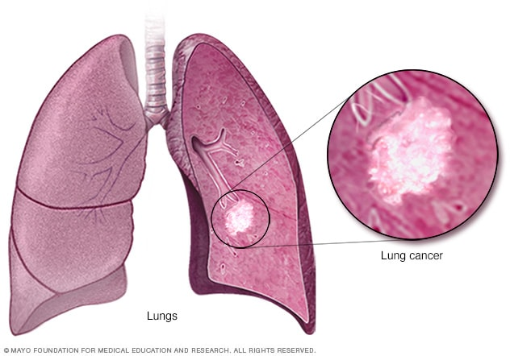
INTRODUCTION
LUNGS CANCER
Lung cancer is a type of cancer that begins in the lungs.
Your lungs are two spongy organs in your chest that take in oxygen when you inhale and release carbon dioxide when you exhale.
Lung cancer is the leading cause of cancer deaths worldwide.

Slide 3
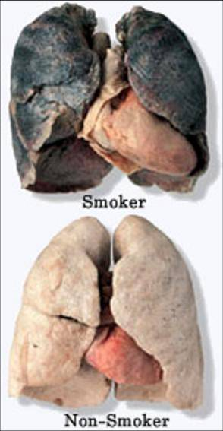
People who smoke have the greatest risk of lung cancer,
though lung cancer can also occur in people who have
never smoked. The risk of lung cancer increases with the
length of time and number of cigarettes you've smoked. If
you quit smoking, even after smoking for many years, you
can significantly reduce your chances of developing lung
cancer.

Slide 4
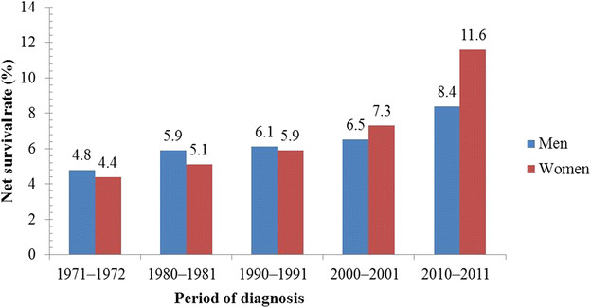
It is one of the leading causes of mortality in every country, affecting both men and
women. Lung cancer has a low prognosis , resulting in a high death rate[1]. Lung disease
which affects the parts of lungs and cause infections such as tuberculosis ,pneumonia and other
breathing problems such as asthma. Lung cancer constitutes 12.8% of all cancer types
worldwide, also it constitutes 17.8% of the cancer deaths and it increases by 0.5% every year
globally worldwide. The cause of cancer in males represents 38.6%, and in females it represents
5.2%. However, it is suggested that 15% of lung cancer patients live 5 years or more after the
diagnosis, together with this early diagnosis and used drugs when they are diagnosed early.
The vast majority (85%) of cases of lung cancer are due to long-term tobacco smoking and
about 10–15% of the cases occur in people who have never smoked.

Slide 5
2.Literature Review
Literature review Machine learning involves several algorithms such as k-Nearest Neighbors
(kNN), support vector machine (SVM), Naive Bayes (NBs), classification tree (C4.5), gradient
boosting machines (GBM), etc. While each of these algorithms processes data differently, in this section, a few recently proposed machine learning candidates in the area of malignant growth finding are reviewed chronologically.
Chen et al. (2013) presented a fuzzy system using kNN (FkNN) for Parkinson’s disease (PD) diagnosis. Besides, they used the principal component analysis to find the most discriminative features on which the optimal FkNN model was built. They compared their system with the
SVM algorithm and found that their proposed method performed better. The best classification accuracy of their FkNN reached to 96.07%.

Slide 6
Odajima & Pawlovsky (2014) declared that the precision of the kNN method changes with the number of neighbors and with the level of information utilized for classification. Meanwhile, they showed details about the variation of the maximum and the minimum values of the
accuracy with the classification set sizes and the number of neighbors. Lynch et al. (2017) applied some supervised learning classification techniques such as linear regression, decision trees, GBM, SVM, and a custom ensemble to the SEER database to order lung cancer patients regarding survival. The outcomes demonstrated that among the five individual models used, the most precise was GBM with a root mean square error (RMSE) value of 15.32. Septiani et al. (2017) compared the performances of C4.5, NBs, and kNN classification algorithms to detect breast cancer diagnosis on 670 data, each with 9 attributes. They showed that while NBs and kNN have the same accuracy of 98.51%, C4.5 is the worst with the accuracy equal to 91.79%.

Slide 7

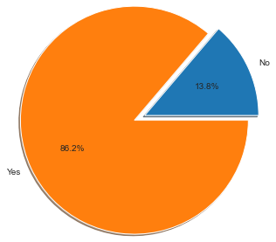
3. Problem Formulation
* Lung cancer can cause complications, such as: Shortness of breath. People with lung cancer can experience shortness of breath if cancer grows to block the major airways. Lung cancer can also cause fluid to accumulate around the lungs, making it harder for the affected lung to expand fully when you inhale. The effectiveness of cancer prediction system helps the people to know their cancer risk with low cost and it also helps the people to take the appropriate decision based on their cancer risk status. The data is collected from the website online lung cancer prediction system.

Slide 8
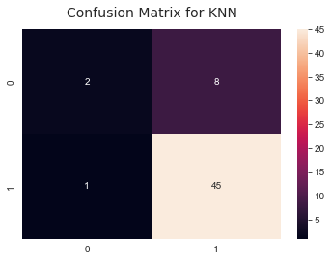
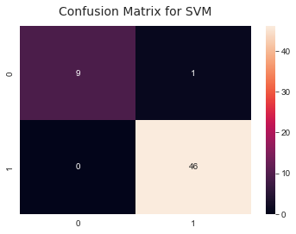
3.1 Objectives
Confusion Matrix
The Confusion Matrix is a deep learning visual
assessment method. The prediction class results are
represented in the columns of a Confusion Matrix, whereas
the real class results are represented in the rows . This
matrix includes all the raw data regarding a classification
model's assumptions on a specified data collection. To
determine how accurate a model is. The confusion
matrix is a 2 x 2 matrix that reports the number of true
positives (T P), true negatives (T N), false positives (FP),and false negative(F N).

Slide 9
4. Design/Methodology
A. Dataset
The data used in this work is a lung cancer dataset that was first released in and later made available in the UCI machine learning repository under the name "Lung Cancer
Data set". This dataset was used to show the capability of the optimum discriminant plane in ill-posed situations. This dataset contains data on the pathological forms of lung
cancer. It contains 32 observations on three forms of lung cancer using 56 elements
B. Classification Models
To compare the output of the classifiers, two classification methods are used. The smallest number of features was used to attain higher efficiency. The classifier models are defined
briefly.

Slide 10
1. Support Vector Machine
Support Vector Machine is a supervised learning algorithm that uses the Classification method to analyze data and predicate patterns. The texture is divided into two categories or classes by the SVM classifier: regular and
abnormal pictures . It is used to effectively map the nodule. SVM is a margin classifier (hyperplane) that separates the two classes, which is why it is often referred to as a non-probabilistic binary classifier. The Support Vector is
described as the training data point that is nearest to the classifier, and the Support Vector Machine is the maximum classifier. The gap between the cancer nodules and the hyperplane is as wide as possible
2. K-Nearest Neighbor Classifier
The KNN algorithm is a supervised classification method. It's a simple algorithm that looks for the nearest fit. The database is compared to the comparison set. The test sample's mark is determined by the closest match of the k nearest neighbors. To calculate the distances between research samples and database samples, various distances such as Euclidean, cosine, similarity, and city block are used.

Slide 11
Block Diagram for Proposed method
Start
Data preprocessing
Feature Selection
Weka classifier
SVM
KNN
Training
Testing
Display accuracy
END

Slide 12



5. Technology/Platform
Window 10
Jupyter Notebook
Python

Slide 13
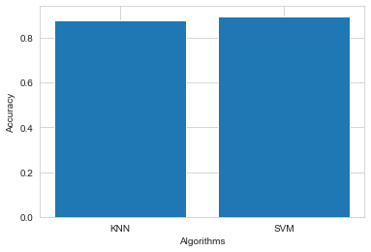
6. Results and Discussion
The model accuracy of KNN : 87%
The model accuracy of SVM : 89%
In comparison between SVM and KNN are shown in this histogram , we see that SVM gives us more accuracy than KNN on the same platform.

Slide 14
7.Conclusion and Future Scope
Lung cancer is one of the most dangerous diseases and the
most common cause of death, the severity of the disease lies
in the difficulty of diagnosing it in the early stages.
The focus of this model is on using WEKA Tool to investigate
the accuracy of classification algorithms. The results show
that the Support Vector Machine (SVM) give the best
accuracy 89.99%, that can detect lung cancer in its early
stages and save several lives and, K-Nearest Neighbor KNN
It gave less accuracy I.e 87.49%.

Slide 15
References
N. Maleki , Y.Zeinali , S.T.A.Niaki (2021) “A K-NN method for lung cancer prognosis with the use of a genetic algorithm for feature selection ”, Expert Systems with application ,vol. 164, pp:1-7.
Dr. S. Senthil , B. Ayshwarya (2018) “Lung Cancer Prediction using Feed Forward Back Propagation Neural Networks with Optimal Features”, International Journal of Applied Engineering Research ISSN 0973-4562, Volume 13, pp : 1-8.
P.Chaturvedi , A.Jhamb , M.Vanani1 and V.Nemade1 (2021) “Prediction and Classification of Lung Cancer Using Machine Learning Techniques”, Materials Science and Engineering , pp : 1-20.
P.Bhuvaneswari , Dr.A.Brintha Therese (2015) “Detection of Cancer in Lung with K-NN Classification Using Genetic Algorithm”, Procedia Materials Science 10:433-440 , pp: 1-10
D.M.Abdullah , A.M.Abdulazeez , A.B.Sallow (2021) “Lung cancer Prediction and Classification based on Correlation Selection method Using Machine Learning Techniques” , pp : 1-9.

